Slide 1
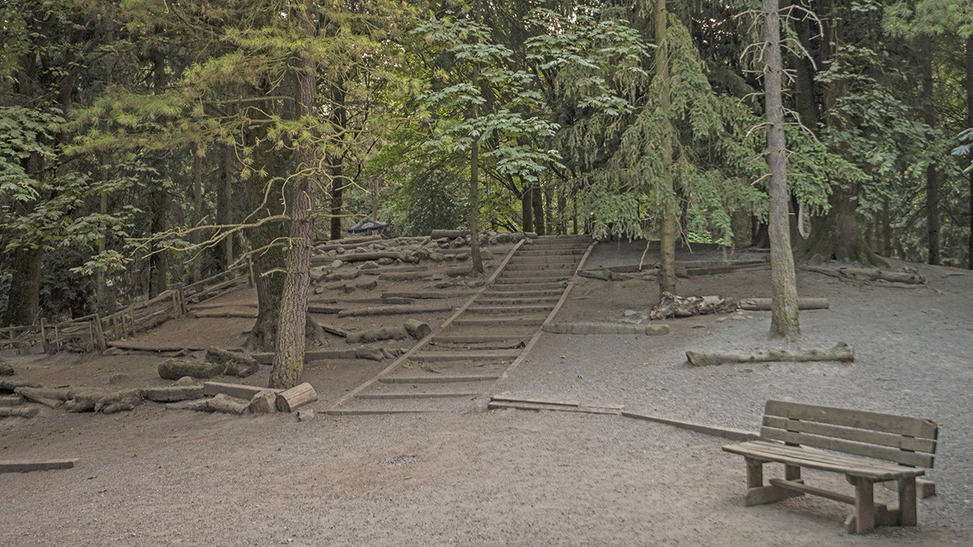
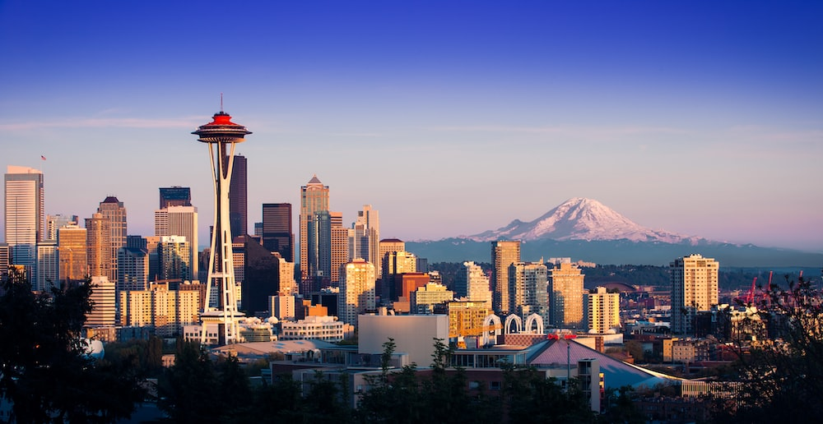
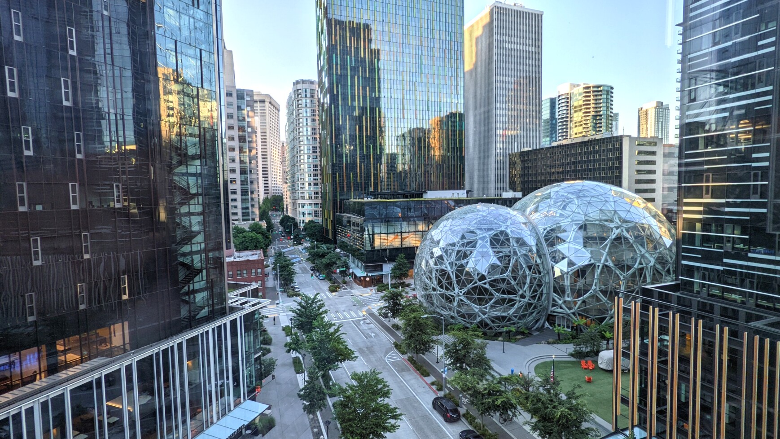
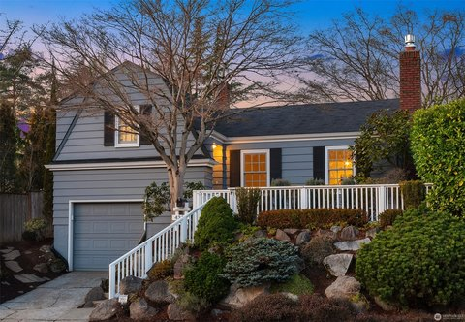

Dropdown Menu
Skyline Image
Neighborhood Image
This is Seattle’s skyline. It seems every year it becomes taller and taller, but the Space Needle is still the star. T1
This is an example of the cozy homes in Seattle’s neighborhoods. Most have basements like this.
T2
Industry Image
Here we see the booming infection that is known to the world as Amazon.
This is a trail at Woodland Park, one of the many beautiful nature areas within the city. T3

Slide 2

Dropdown Menu
Seattle Currently 68° Hi: 69° / Lo 49°
This is Seattle’s wonderful skyline.
Neighborhood example
Nature example
Industry example

Slide 3

Dropdown Menu
Seattle Currently 68° Hi: 69° / Lo 49°
Skyline Image
This is Seattle’s beautiful skyline. T1
Industry Image
Nature Image
A lovely trail in Woodland Park, one of many healthy areas in the city. T4
This is an example of Seattle’s cozy houses. T2
An example of the infection known as Amazon. 3

